Slide 1

DS 3000 Yelp Star Prediction
Vanessa Lee, Megan Lau, Rachel Li
SEC02 Group 12

Slide 2
01
Introduction

Slide 3
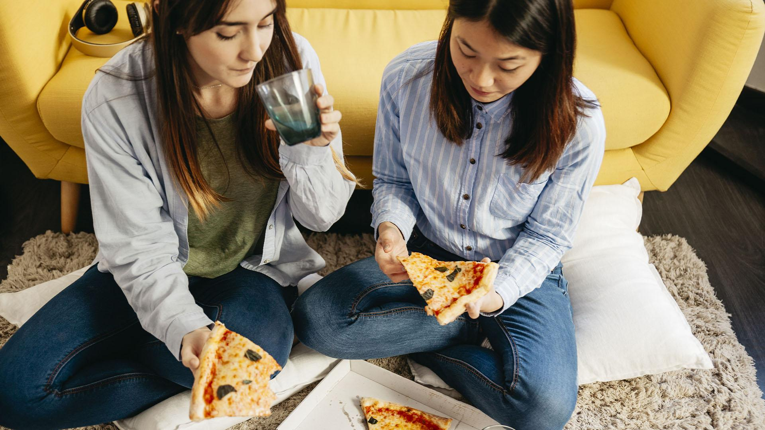
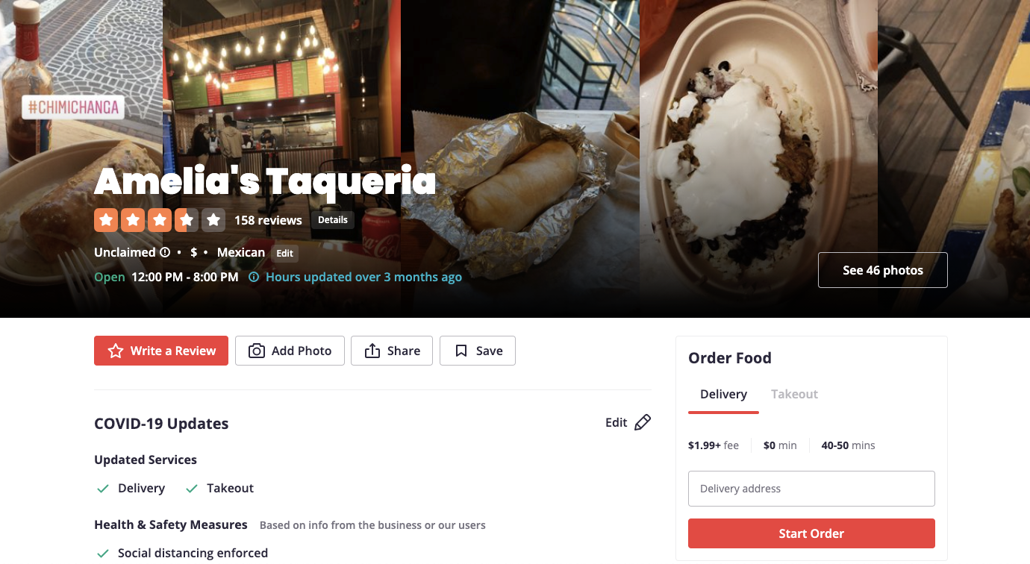
Yelp is a platform for crowd-sourced reviews about businesses. User Reviews and Recommendations of Best Restaurants, Shopping, Nightlife, Food, Entertainment, Things to Do, Services and More at Yelp.
Notes:
Yelp dataset provides data on businesses, like location, num reviews, average star rating, and amenities provided. Chose to focus on restaurants to determine which features of restaurants are most important when customers are rating restaurants.

Slide 4
Machine Learning Plan
Predictive Model
Supervised Learning Problem
Machine Learning Algorithm
Given the dining amenities and perks restaurants have, we will be predicting the star ratings to find which machine learning algorithm and hypotheses are true.
This is a supervised learning problem, sub-categorized to classification because the star ratings are categorical values (half and full stars from 1 to 5).
We will be using k-Nearest Neighbor, SVM, and Decision Tree algorithms.
Notes:
Predicted star ratings of restaurants based on the features they have

Slide 5
02
Method

Slide 6
Dataset
Independent Variables (feature variables)
Dependent Variable (target)
average star rating (half and full stars from 1 to 5)
latitude
longitude
population
review_count
is_open
alcohol
good_for_kids
reservations
delivery
takeout
accepts_credit_cards
parking
Notes:
Vanessa

Slide 7
03
Results

Slide 8
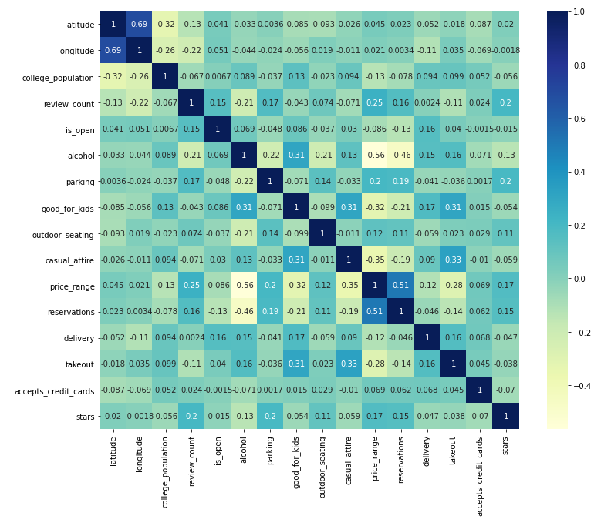
Heat Map Visualization
Used matplotlib.pyplot and seaborn to create a heat map.
Calculates correlations (-1 to 1) between two variables (columns) from the dataset.
Notes:
Vanessa

Slide 9
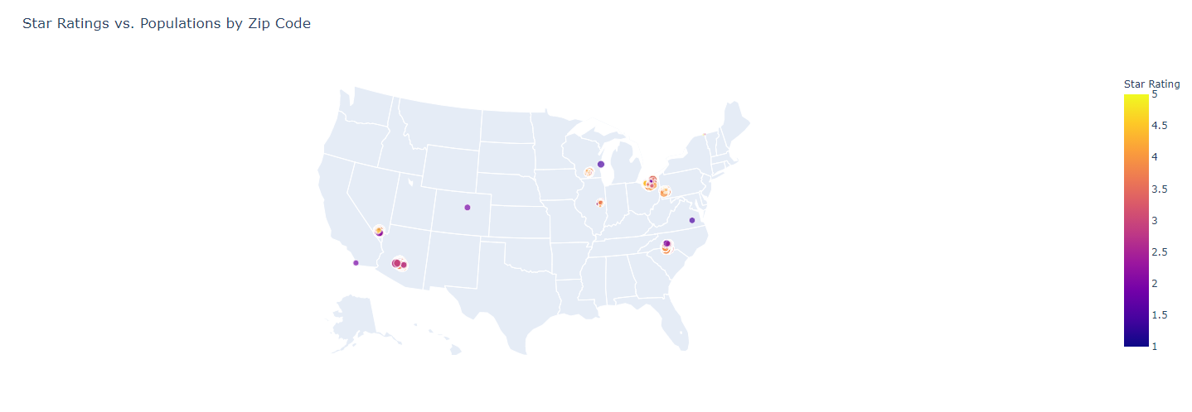
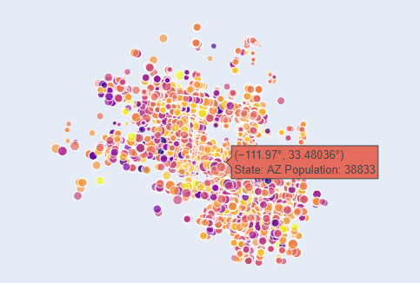
Population VS Star Rating Map
plotly.graph_objects.Scattergeo object plots restaurants based on longitude and latitude.
Dot sizes correlate to population size based on the restaurant’s zip code.
Notes:
Megan
Next we had the population vs star rating map. The map shows the location of yelp restaurants in the States by zip code with the population of the location. We used the plotly scatter geo object to plot the restaurant by longitude and latitude. The dot size correlate to the population size so you can see here yellow is high star ratings of 5 and purple is low star rating up to 1. If you hover over the dots, you can see the population size rating for the restaurant with the corresponding color.

Slide 10
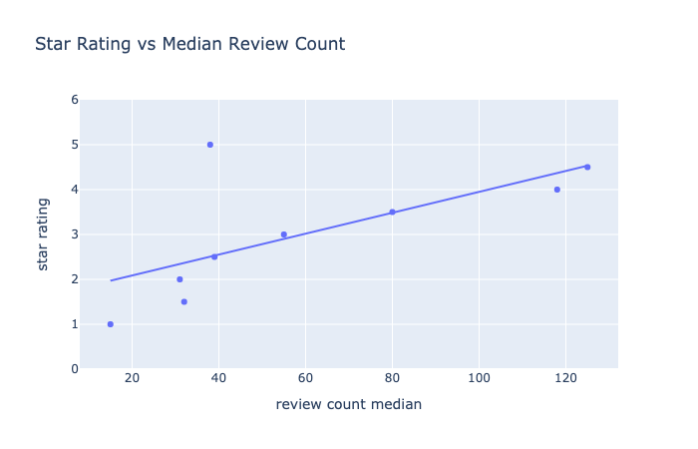
Review Count VS Star Rating Scatterplot
Correlation between review counts and star rating.
Besides the 5 star rating, star ratings from 1 to 4.5 and the median review count have a positive correlation.
Makes sense that 5 star ratings have less review counts, since it is less likely for a restaurant with many customer ratings and reviews to have a perfect average star rating.
Notes:
rachel

Slide 11
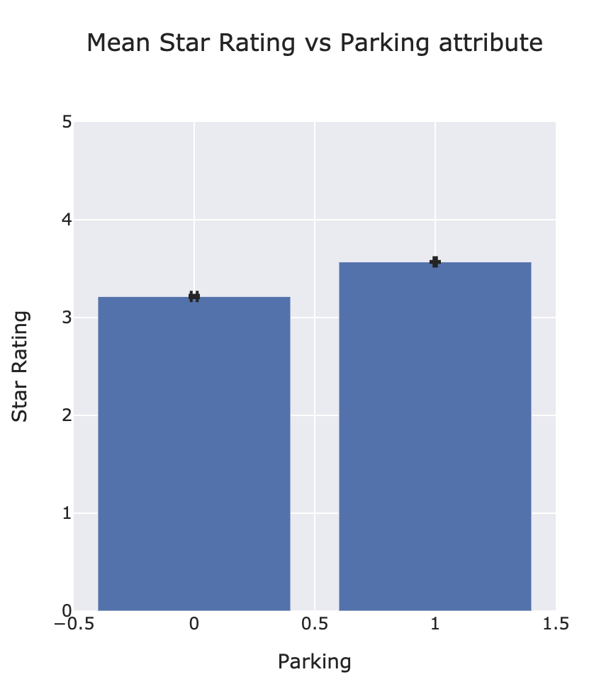
Hypothesis testing: parking vs no parking
Hypothesis about having restaurant parking vs rating:
Null: The star ratings of restaurants that have available parking and restaurants that don't are the same.
Alternative: The star ratings of restaurants that have available parking and restaurants that don't are not the same.
Test and Purpose:
Mann-Whitney U Test was conducted to compare the star ratings of restaurants that has no parking and parking that sell alcohol.
Actual results:
Results showed a statistically significant difference between the conditions:
t(22120) = 32179606.00, p < .001.
Meaning:
These results indicate that restaurants that has parking does affect the Yelp star ratings.
Notes:
Megan - Our first hypothesis was whether a restaurant have parking or no parking changes. We used a mann whitney u test because we had two in between features that are non parametric. The results showed we had a p value less than 0.001, that we reject null hypothesis and accept that parking does have a relationship but we cannot conclude that its a positive or negative relationship.

Slide 12
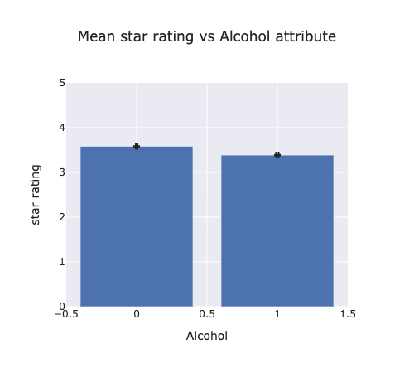
Hypothesis testing: alcohol vs no alcohol
Hypothesis about serving alcohol vs rating:
Null: The star ratings of restaurants that serve alcohol and restaurants that don't serve alcohol are the same.
Alternative: The star ratings of restaurants that serve alcohol and restaurants that don't serve alcohol are not the same.
Test and Purpose:
Mann-Whitney U Test was conducted to compare the star ratings of restaurants that don't sell alcohol and restaurants that sell alcohol.
Actual results:
Results showed a statistically significant difference between the conditions:
t(22120) = 54738842.00, p < .001.
Meaning:
These results indicate that restaurants that don't sell alcohol and restaurants that do differ in star ratings on Yelp. Providing alcohol is significant in determining star ratings.
Notes:
rachel

Slide 13
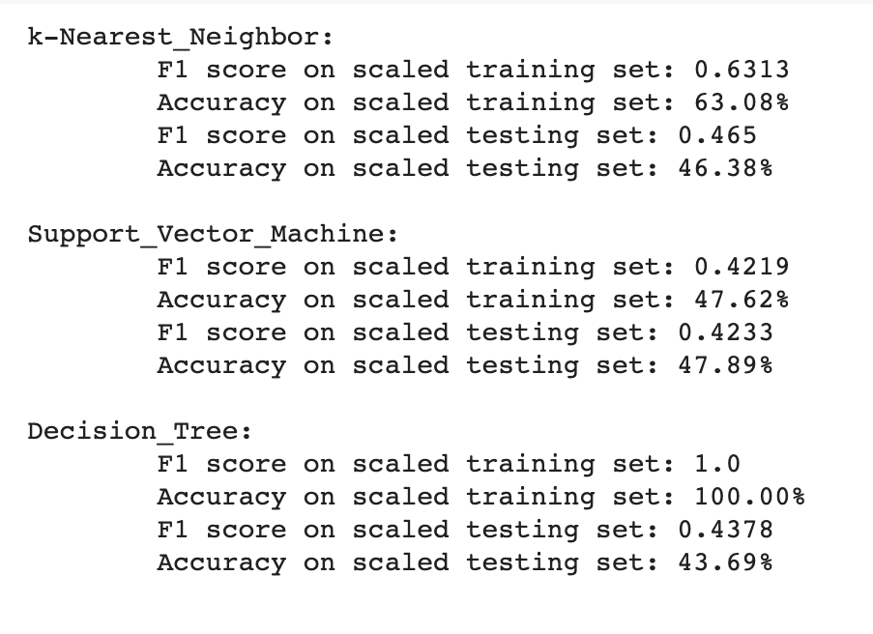
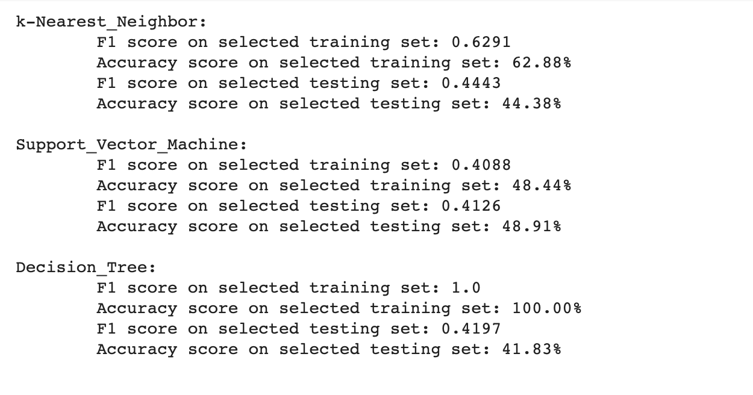
Machine Learning Hypothesis
Hypothesis about machine learning algorithm:
Null: KNeighbors, SVM, and Decision Tree algorithms do not differ significantly in performance and accuracy.
Alternative: KNeighbors, SVM, and Decision Tree algorithms differ significantly in performance and accuracy.
Before hyperparameter tuning, we cannot conclude which ML algorithm performed the best due to overfitting for Decision Tree and KNeighbors, thus, failing to reject or not reject the null hypothesis.
Notes:
Vanessa
However, F1 and accuracy scores were compared between scaled data and selected data (based on the scaled data). There are slightly higher F1 and accuracy scores for scaled data than selected data, but we cannot conclude that scaled data leads to better performance of ML algorithms than selected data.

Slide 14
04
Discussions

Slide 15

Conclusion and Future Work
Best Performance: Decision Tree algorithm
Best for Predictive Model: TBD
Overall, the performance of our algorithms was not super high (< 50% accuracy).
An application of this research is for customers to have a better sense of what restaurants are “good”.
In the future, to improve the performance, we would find more features that are significant in determining a restaurant’s Yelp star rating.
We could also look into different datasets that are not from Yelp, such as Uber Eats and DoorDash that looks at specifically delivery.
Notes:
Vanessa
We noticed that most of our features had a low correlation with a star rating, which may have decreased the performance of our algorithms. For example, we could have a population of nearby colleges as a feature, since college students may tend to give higher ratings. Finding other datasets to join with out yelp data to see if other features not covered in what Yelp gives us. Our dataset may also not have been large enough to truly reveal which features are significant in predicting star rating. In the future, we would use more data to produce a more accurate analysis of the features that significantly affect star ratings of restaurants.

